Slide 1
Sentiment Analysis using Chatbot
Final Presentation
By Runtime terror

Slide 2

Overview
Sentiment Analysis identifies and categorizes opinions expressed in a text to determine whether the sentiment is positive, negative, or neutral.
Real-Time Interaction:
Chatbots can analyze sentiment in real-time during conversations with users.
Continuous Learning:
Modern chatbots can learn from interactions, improving their sentiment analysis capabilities.
Scalability:
Capable of handling large volumes of interactions simultaneously.

Slide 3
Data Overview
Dataset: 6 features and 1599999 observations.
Id
Sentiment
Date
Query
Username
Text

Slide 4

Data Cleaning and Preparation
Renaming columns
Dropping columns
Missing values (non)
Removing symbols from text

Slide 5
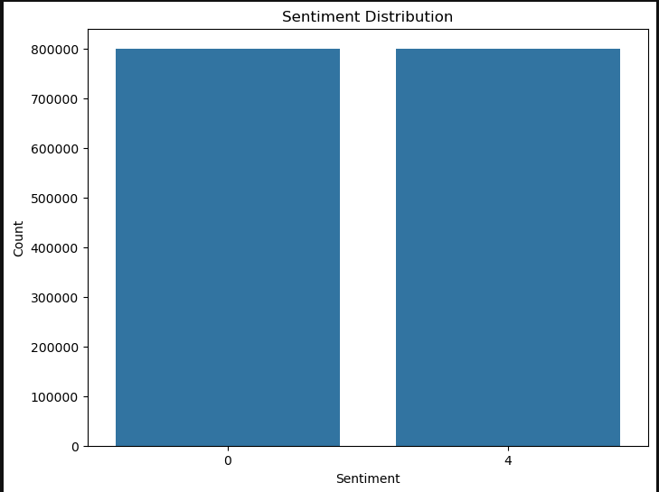
Feature Engineering
TF-IDF Vectorization:
Convert reviews into numerical features using unigrams and bigrams for richer text representation.
Word Cloud Analysis:
Visualize and identify key terms from reviews to guide feature selection

Slide 6
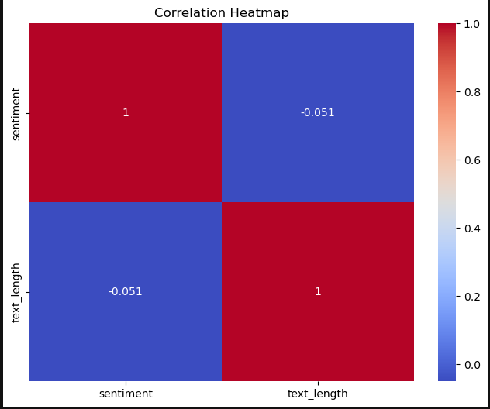
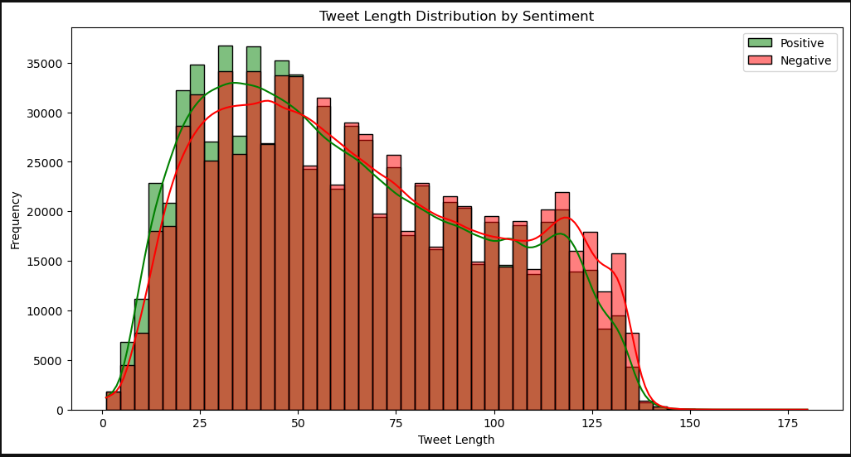
DATA ANALYSIS
The overlayed lines in the histogram show that while both sentiments have similar distributions, negative tweets are slightly more frequent across most tweet lengths.
This correlation heatmap shows a weak negative correlation (-0.051) between sentiment and text length showing that it has little to no linear relationship with sentiment in this dataset.

Slide 7
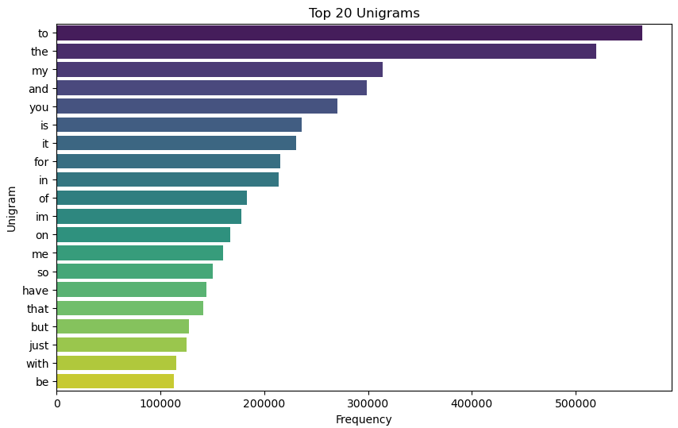
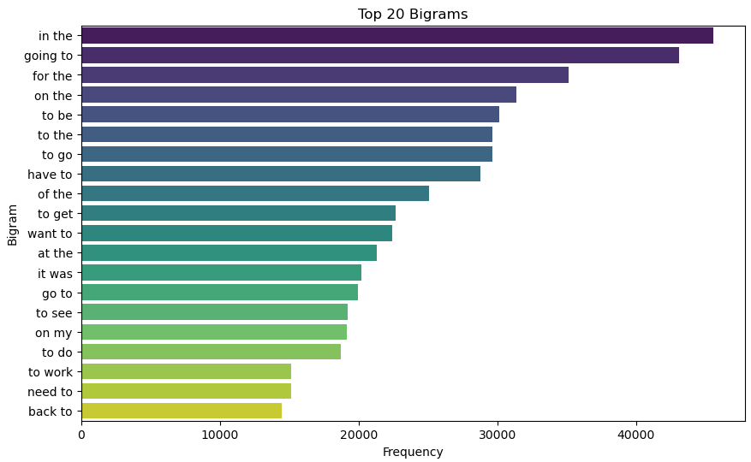
UNIGRAMS AND BIGRAMS

Slide 8
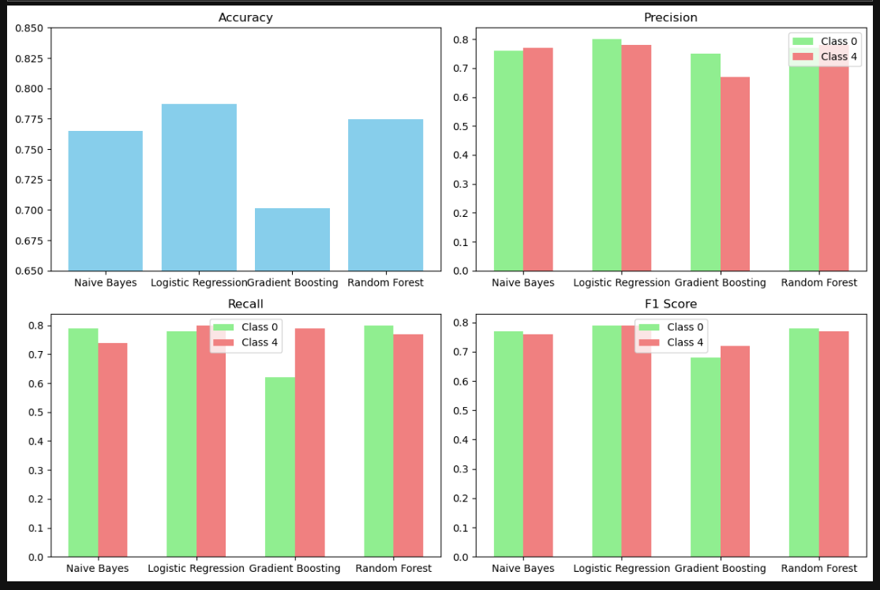
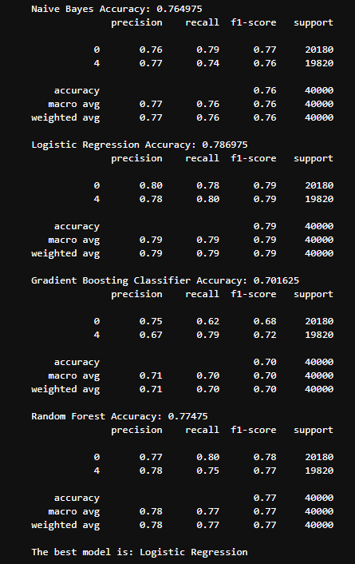
Model Evaluation
This comparison of model performance metrics shows that Logistic Regression achieved the highest accuracy (78.7%) and balanced precision, recall, and F1-score across classes, making it the best-performing model among the four tested.

Slide 9
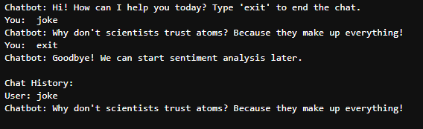
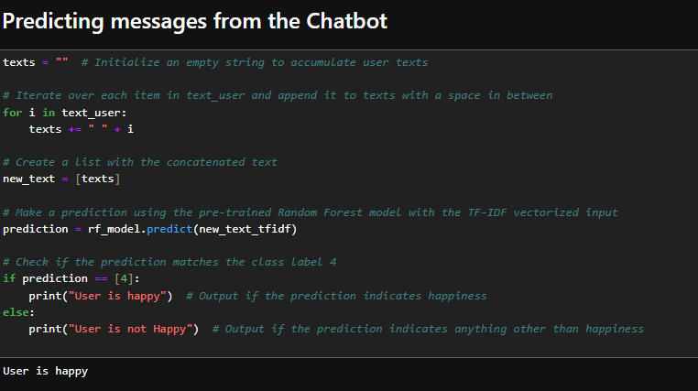
CHATBOT
The chatbot interacted with the user by responding to a joke request and later determined the user's sentiment using a pre-trained Random Forest model.
Based on the input provided by the user, the model predicted that the "User is happy," which aligns with the positive nature of the interaction.

Slide 10
FUTURE WORK
YouTube Playlist Comment Analysis
Objective:
Extract and analyze comments from a YouTube playlist to predict the overall sentiment and classify the comment section type (e.g., Positive or Negative).
Data Extraction:
Collected comments from all videos in the playlist using YouTube's API and then preprocessed.
Feature Engineering:
Applied TF-IDF vectorization and sentiment scoring to convert text data into meaningful features.
Model Prediction:
A pre-trained model (e.g., Random Forest) was used to predict the sentiment and classify the comment section of the playlist.

Slide 11
Data Processing
Data Extraction:
Collected comments from all videos in the playlist using YouTube's API.
Text Preprocessing:
Cleaned and preprocessed the text data (e.g., removing stop words, lowercasing, tokenization).
Feature Engineering:
Applied TF-IDF vectorization and sentiment scoring to convert text data into meaningful features.
Model Prediction:
A pre-trained model (e.g., Random Forest) was used to predict the sentiment and classify the comment section of the playlist.

Slide 12
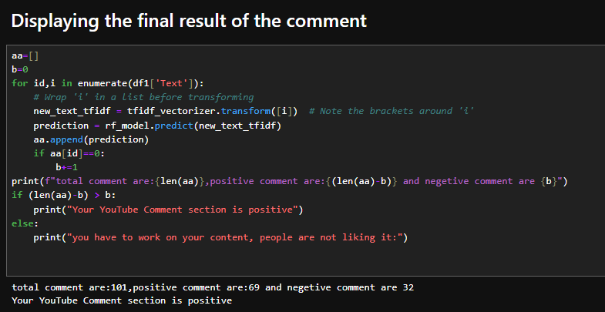
Analysis

Slide 13

Conclusion
Sentiment Analysis
Feature Engineering:
YouTube Comment Insights:
Practical Applications/Future Work

Slide 14


